Slide 1

J.D. Salinger’s ‘Just Before the War with the Eskimos’
Presentation by Peter Edmund Thomas Conroy

Slide 2
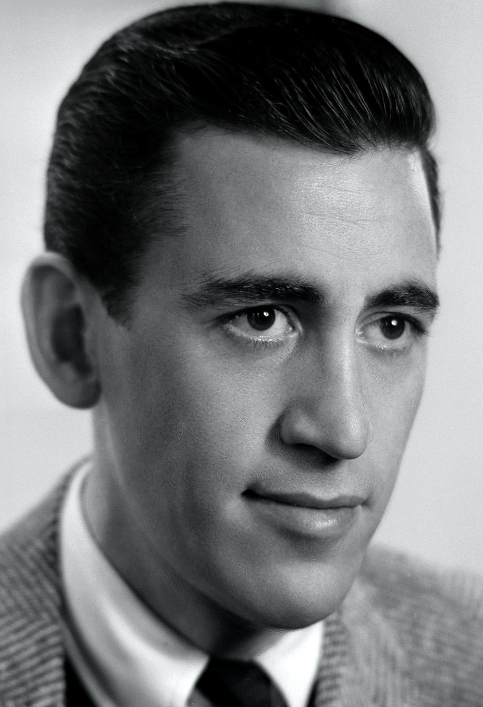
Background
J.D. Salinger
Just Before the War with the Eskimos
New Yorker Magazine
Public Domain image of J.D. Salinger

Slide 3

Background
Nine Stories (Anthology)
Fair Dealing usage: Low Res. Image of 1st Edition of ‘Nine Stories’ cover

Slide 4
Overview
It is the story of a young girl on the cusp of adulthood meeting a disenfranchised young male, the brother of her ‘friend’; and also his friend – it is a tale of redemption, alienation, rejection, judgement and self-reflection.
Characters: Virginia “Ginnie” Mannox; Franklin Graff; Selena Graff and Eric, Franklin’s friend.

Slide 5
Genre & ChARACTERISTICS
Difficult to place
Love Story?
Coming of Age?
Morality Tale?

Slide 6
Love STORY?
“You wouldn’t have to go, anyway” and “I’m in no hurry. Thank you.”
““…Maybe I can over.” Selena stared and said, “O.K.” Ginnie opened the front door and walked to the elevator. She rang the bell. “I met your brother,” she said.” (p. 7 of 8)
The chicken sandwich half

Slide 7
Coming of age
REJECTION THEME:
  Army
  Joan
  Society
  Old Money
  The Writer

Slide 8
Coming of age
INNOCENCE THEME:
  Ginnie
  Francis
  The Eskimos

Slide 9
Morality tale
SELF-ABSORBTION:
  Ginnie
  Selena
  Franklin
  Eric
  Society

Slide 10

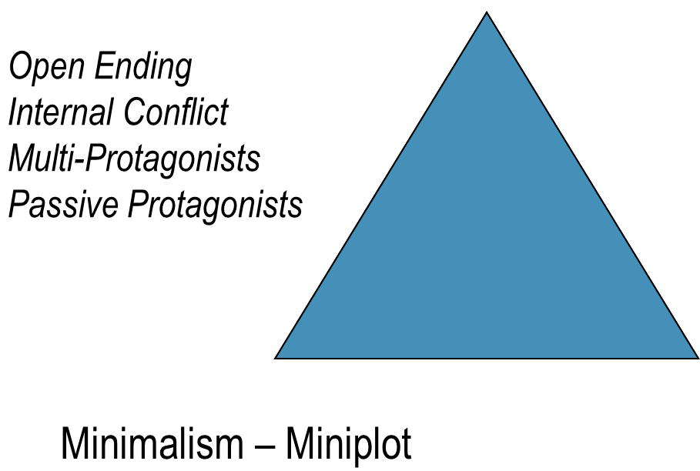
NARRATIVE STRUCTURE
Branching narrative?
Mini Plot?
Three Acts

Slide 11
MORE BACKGROUND: SELENA
Who is Selena?
Mother
Father
Francis
The maid
Selena – Ego, Self-Absorbed & Self-Centred

Slide 12
SELENA
WEALTH
123
CATCHER IN THE RYE
WEALTH

Slide 13
selena & ginnie
At the start
At the end

Slide 14
Selena & ginnie
WHY?
  Saving Selena?
  Chasing Franklin?
  Anytime you need a friend?
  All three/mixture

Slide 15
Character archtypes
HEROS
VICTIMS
FALSE-HEROS
VILLIANS
DONOR
HELPER
PRINCESS
DISPATCHER

Slide 16

HERO
Ginnie?
Yes?
Humanity

Slide 17
Hero
Franklin
Eric

Slide 18
Some more descriptions
MEDIATION
STRUGGLE
UNRECOGNISED ARRIVAL
TRANSFIGURATION
Vladimir Propp

Slide 19
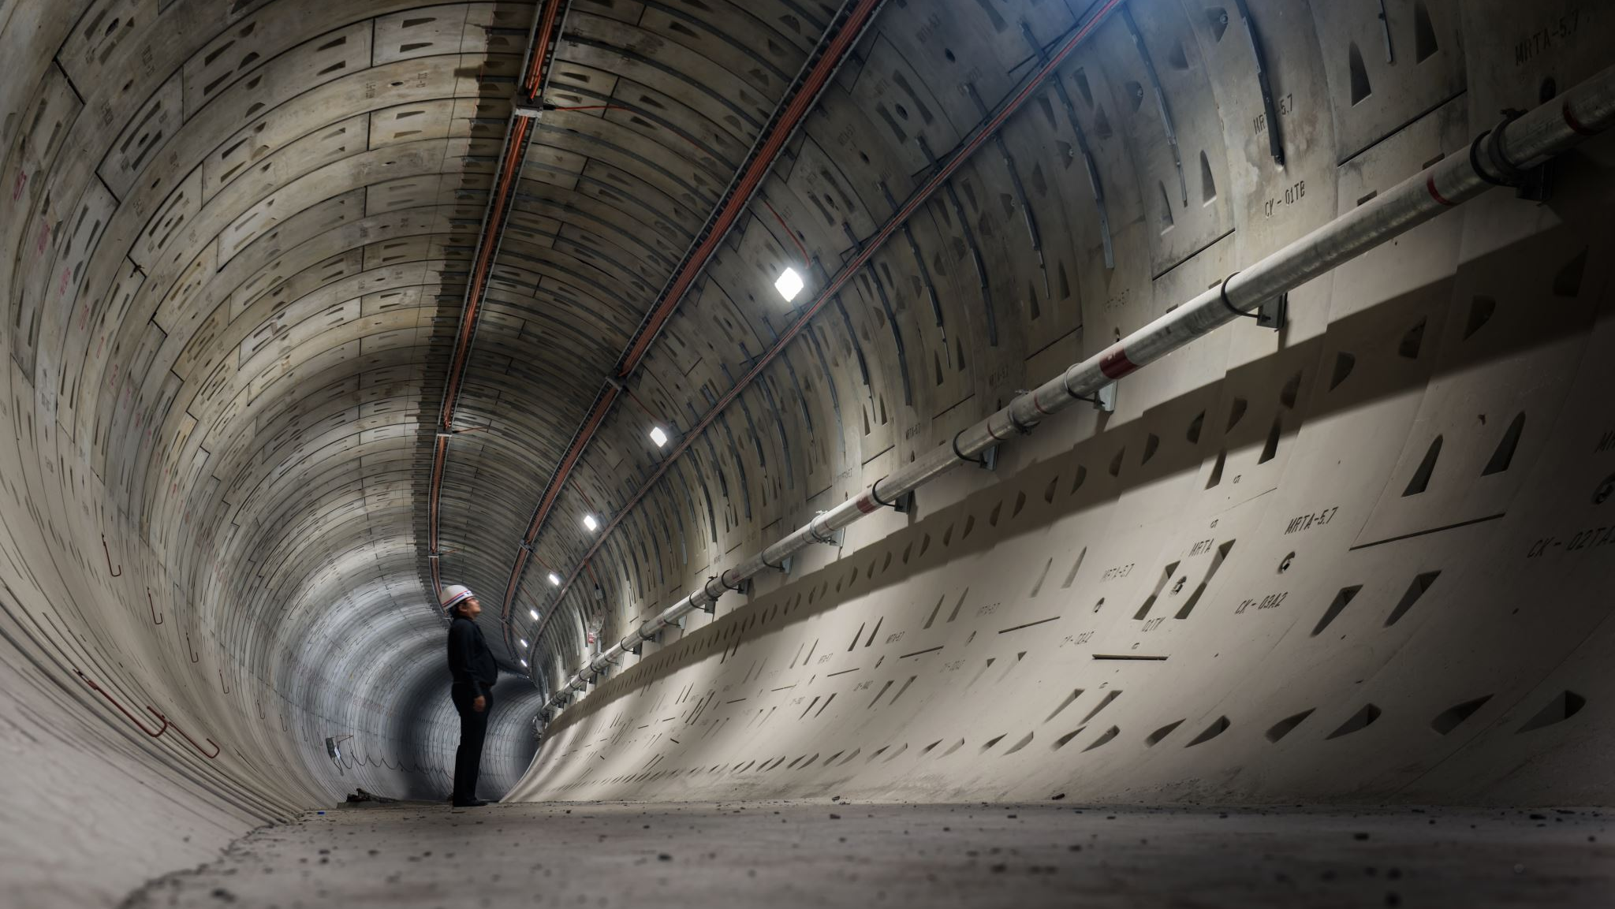
VOICE & POINT OF VIEW
3rd Person
  Speech
  Perspective
  Hero

Slide 20
THEMES & MOTIFFS
JUDGEMENT
WAR
INNOCENCE
MATERIALISM
SELF-ABSORBTION/EGO

Slide 21
ENIGMAS & CONFLICT
The sandwich
The debt
Materialism
Juxtapositions
How innocent is innocent?

Slide 22
Conclusion
Human Condition
Snapshot of life

