Slide 1

J.D. Salinger’s ‘Just Before the War with the Eskimos’
Presentation by Peter Edmund Thomas Conroy

Slide 2
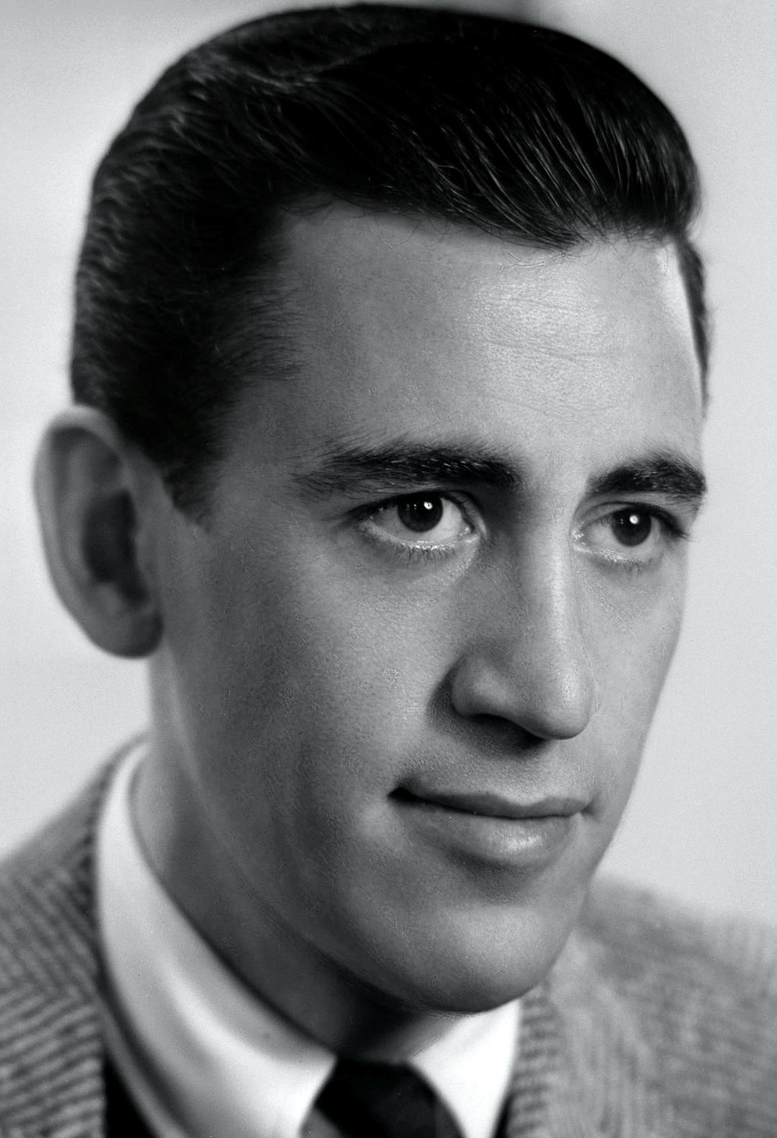
Background
J.D. Salinger
  1919 – 2010
  The Catcher in the Rye (1951)
  Two of his most famous short stories: A Perfect Day for Bananafish and For Esmé - with Love and Squalor
Just Before the War with the Eskimos
New Yorker Magazine
  His New Yorker work began with A Perfect Day for Bananafish on January January 31, 1948
  Just Before the War with the Eskimos was published in the June 5th 1948 edition of The New Yorker
Public Domain image of J.D. Salinger

Slide 3

Background
Nine Stories (Anthology)
  8 of these short stories were published in The New Yorker in 1948
  The only one of the 9 stories not to be published in The New Yorker was Down at the Dinghy which was published in 1949 in Harper’s Magazine
  Nine Stories was published in 1953 in the US, and internationally often goes by the title of one of the nine stories: For Esmé - with Love and Squalor, and Other Stories.
Fair Dealing usage: Low Res. Image of 1st Edition of ‘Nine Stories’ cover

Slide 4
Overview
It is the story of a young girl on the cusp of adulthood meeting a disenfranchised young male, the brother of her ‘friend’; and also his friend – it is a tale of redemption, alienation, rejection, judgement and self-reflection.
The main character is Virginia “Ginnie” Mannox
The main protagonist is Franklin Graff
Supporting Characters are Selena Graff (Franklin’s younger sister, and Ginnie’s “friend” and Eric, Franklin’s friend.
Tertiary Character: Unnamed maid (more about them later) and an unseen referenced ‘writer’.

Slide 5
Genre & ChARACTERISTICS
Difficult to place
Some have called it a love story
Because of Ginnie’s desire to return and her fascination with Franklin
Some have called it a ‘coming of age’ story
This seems to fit a little more, as it tackles the themes of rejection, society (where do I fit in) and young adults in their quest for meaning.
It could also be a morality tale
Ginnie comes, perhaps, to the realisation that she herself has been too self-absorbed, with regards to the quest for money (though perhaps her dismissal of Selena’s mum’s pneumonia)

Slide 6
Love STORY?
“You wouldn’t have to go, anyway” and “I’m in no hurry. Thank you.” – These statements from Ginnie to Franklin are examples of possibly the things someone with a crush might say around/to their crush
““…Maybe I can over.” Selena stared and said, “O.K.” Ginnie opened the front door and walked to the elevator. She rang the bell. “I met your brother,” she said.” (p. 7 of 8) – Ginnie wishes to come over tonight, and then mentions Selena’s brother, ulterior motive to her night-time visit? The following conversation is about Franklin, it’s gossipy, girly and isn’t particularly important – she finds out more about Franklin – e.g. the things a girl with a crush would want to know?
The chicken sandwich half – does she keep it because of the Easter-Chick sentimentality, or, because she actually wants a token memory of Franklin?

Slide 7
Coming of age
REJECTION THEME:
  Franklin’s rejection by the Army draft of WWII (due to ill health)
  Franklin’s rejection by Ginnie’s sister – Joan (who never replies to his 8 letters)
  Franklin’s rejection of society – he looks out the window and the people on the street and says: “Goddam fools… I don’t know. Anybody… They’re all goin’ over to the goddam draft board… We’re gonna fight the Eskimos next.”
  Franklin’s rejection of ‘old money’: Ginnie comes from, her sister is a ‘snob’ presumption that Ginnie is also a ‘snob’?
  Eric’s ‘writer’ leaving: IF Eric is gay then this could be a rejection of Eric, he may also have been rejected by society for being gay – but this is not concretely, he is effeminate: “The young man broke it off” (p. 6)

Slide 8
Coming of age
INNOCENCE THEME:
  Ginnie: “Virginia” is innocent; Children are innocent – she is a juxtaposition to the ‘contamination’ of Franklin and Eric by the ‘world’ and it’s cares and fears – she is care free, she is full of child innocence and wonder – but also teenager fears, cares and prejudice.
  Franklin is innocent because he is child-like, he displays autistic tendencies – such as his obsession with his finger – but Ginnie’s ‘mothering’ sooths him – whilst he is an adult (24 years old) he is still very young in his outlook, rebellious in his rejection of the materialism and war mongering of America.
  The Eskimos are innocent: “War, whatever its cause, represents egoism and materialistic greed of each nation and supports imperialism. The Eskimos, living away from materialism, symbolize innocence. Franklin predicts with the bitterest sarcasm that America, which is so foolish as to continue wars, will be sure to go and fight the innocent Eskimos next.” (Hayase) It should also be noted that in line with Salinger’s prediction America would follow WWII with Korea and Vietnam and the lingering cold war with Russia and in part China. One could also note it’s continued participation and acts of war in countries rich in oil – which I think fit very well with Slinger’s thinking.

Slide 9
Morality tale
SELF-ABSORBTION:
  Ginnie is self-absorbed about the owed money (note her ‘uncaring comment’: “I didn’t give it to her,” (p. 2) about Selena’s mum’s pneumonia.
  Selena is self-absorbed – her view is that those ‘free tennis balls’ are enough: “I always bring the tennis balls, don’t I?” Selena asked unpleasantly.” (p. 1)
  Franklin is self-absorbed about his own life and situation, including his finger – he is more interested in everything but the conversation he is having with Ginnie: “Selena’s brother turned back to his finger, obviously for him the true and only focal point in the room.” (p. 3) - Hironori Hayase calls him ‘autistic’ in his self-absorption.

Slide 10
Morality tale
SELF-ABSORBTION:
  Eric is self-absorbed about his ‘writer’ friend: he only briefly takes a specific interest in Ginnie, and only when it is related to him – their mum’s mutal trips to Nassau; and also he then asks for a name, in case there is a connection etc – there isn’t so he moved on. (p.6 & 7)
  And then the world’s self-absorption via its rejection of each of the characters, primarily Ginnie and Franklin, but also possibly Eric and maybe even Selena

Slide 11

NARRATIVE STRUCTURE
Four Scenes, reminiscent of the branching narrative structure of Truby:
  In this sense Ginnie becomes the main trunk of the story, and the others are branches off this – but unlike most ‘branching narratives’ this one is chronologically linear

Slide 12

NARRATIVE STRUCTURE
  “The fact that the other three characters do not exist in the same scene means that they have no relation with each other: Eric and Franklin are not such close friends though they go to the movies together; there is no real brother-sister relation between Franklin and Selena; besides, the reason why Selena is absent during Ginnie's conversations with Franklin and Eric is that Selena is so indifferent to Ginnie and her trouble and their relation is not so close.” - Hironori Hayase, "Money or the Sandwich Half?“’ Salinger's "Just Before the War with the Eskimos“, 1996

Slide 13
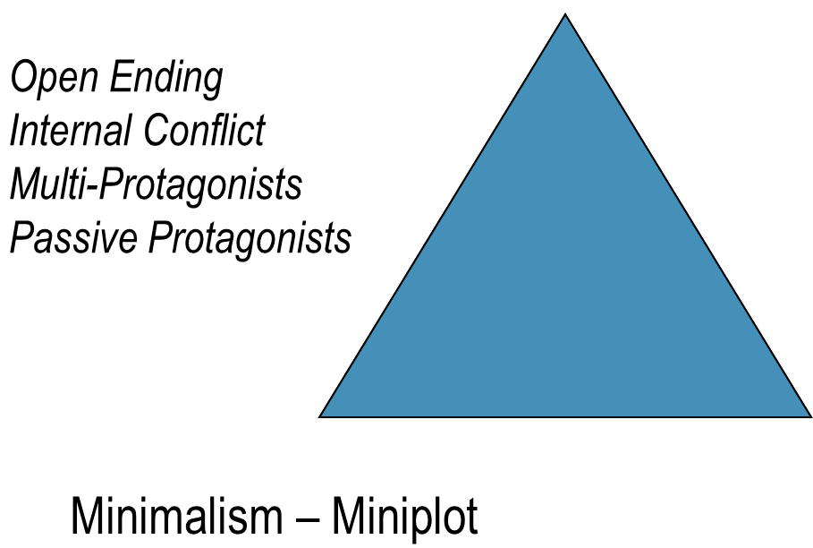
NARRATIVE STRUCTURE
However, this fails to recognise that the story follows a short classic drama, however, it has been noted that it is well structured if not well balanced (Hayase, 1996) because it is “mechanical” (Warren French, J. D. Salinger, 1976) in this sense it is clearly more of a Mini-Plot than a Classical Arch-Plot. Especially with the open ending

Slide 14
Three act structure
If viewed purely from the Ginnie perspective, we could say there is a three-act structure, the classic narrative structure – the beginning is the first scene with Selena and Ginnie, the middle with Ginnie meeting Franklin – the pinnacle of the story, and then the third scene with Eric and the final with Silena are the final denouement of the piece.

Slide 15
A BIT MORE BACKGROUND: SELENA
It all comes back to the issue of why Ginnie relented and didn’t demand the money from Selena in the end… There are cues which suggest that Ginnie realised that Selena came from a loveless family – where they may have been wealthy but the inter-connection between families was missing:
Mother is sick in bed: “…“that my mother is very ill.”...“She virtually has pneumonia, and if you think I’m going to enjoy disturbing her just for money…” (p. 2)
Father is working (and absent): "Selena's father made them or something. (At dinner one night, for the edification of the entire Mannox family, Ginnie had conjured up a vision of dinner over at the Graffs'; it involved a perfect servant coming around to everyone's left with, instead of a glass of tomato juice, a can of tennis balls.)” (p. 1)
Francis: As already mentioned, Francis is never in a ‘scene’ with Selena, it suggests that they have no real relationship.
The maid: “…with whom Selena didn't seem to be on speaking terms” (p. 2)

Slide 16
A BIT MORE BACKGROUND: SELENA
Selena is therefore self-absorbed/self-centred and egotistical:
“Then Selena, who was seated nearest the curb, let herself out. Just barely leaving the cab door open, she walked briskly and obliviously, like visiting Hollywood royalty, into the building. Ginnie, her face burning, paid the fare.” (p. 1)
““I always bring the tennis balls, don’t I?” Selena asked unpleasantly.” (p. 1)
“Selena had changed from her shorts to a dress, a fact that ordinarily would have annoyed Ginnie… “I’m sorry to’ve kept you waiting,” Selena said insincerely…” (p. 7) – having left Ginnie alone.

Slide 17
A BIT MORE BACKGROUND: SELENA
Selena is from a similarly wealthy family to Ginnie, though it is inferred that Ginnie is ‘old money’ and Selena is from the ‘new money’ – there are the pressumptions of old vs new money:
“She looked around the room, mentally rearranging furniture, throwing out table lamps, removing artificial flowers. In her opinion, it was an altogether hideous room--expensive but cheesy.” (p. 2)
When looked in the context of Salinger’s Catcher in the Rye, we can assert:
“Such a materialistic relation is therefore broken by a problem of small money. This story reveals how relationships in our society have become hollow and materialistic.” (Hayase, p. 77)

Slide 18
Start to finish: selena & ginnie
At the start Ginnie would describe Selena as “a classmate” (p. 1); as “…the biggest drip…[in]…a school obstensibly abounding with fair-sized drips...” (p. 1) and when asked if she is a “Friend of the jerk’s?” (p. 2) by Selena’s brother she retorts “We’re in the same class.” (p. 2) – should also be noted that Selena comments: “I never in my life would’ve thought you could be so small about anything,”… with Ginnie responding “Now you know,” (p. 2) and also important to note that whilst Selena held Ginnie in fair esteem, Ginnie is using Selena: “but at the same time she had never known anyone like Selena for bringing fresh cans of tennis balls.” (p. 1)
At the end of the story, Ginnie is making arrangements, which are essentially ovatures of friendship, probably, assuming the alterior motive is gone. She forgives the taxi money, and is quick to leave but makes plans to return to Selena’s that night.

Slide 19
Selena & ginnie
The biggest question literary analysis has is WHY????
  1. Ginnie is trying to save Selena from the ‘disaffected’ and ‘rejected’ existence that her brother, Franklin has
  2. Ginnie has an intimate bond with Franklin (though not necessarily reciprocated) and is using Selena to get in good with her brother
  3. Ginnie genuinely feels the need to connect with Selena
  4. All three/mixture: Humanity rarely acts with one motive, and to assume a write with the unfortunate talent of Salenger:
    “That's the penalty Salinger has to pay for being such a good author. He can write rings around most of the others in his generation. (He was born in 1919). The result is that when he comes along with a book that would make the reputation of any one of a dozen gifted young fogies we complain because it's not better than "The Catcher in the Rye.“” (Charles Poore, Book of the Times, in The New York Times, April 9, 1953)

Slide 20
Character archtypes
HEROS:
  Ginnie/Franklin/Eric
VICTIMS:
  Ginnie/Eric/Selena
  Franklin
  The Writer
  The Eskimos
FALSE-HEROS:
  Eric
  The Army
VILLIANS:
  Ginnie/Selena
  The Writer
  Materialism
  Society
DONOR:
  Franklin/Eric/Ginnie
Helper:
  Franklin/Eric
Princess:
  Selena/Ginnie/Joan
Dispatcher:
  Selena

Slide 21

HERO
So is Ginnie a hero?
Yes, She is trying to save Selena from herself/her family and the course that leads to Franklin, she is also the main character, not franklin of this story… but remember my words:
“Humanity rarely acts with one motive…”
We are all the hero’s of our own story, and I think that is exactly what Salinger was saying, when he also created the story with parallel perspectives…

Slide 22
Hero
Franklin is the hero of Ginnie’s story – he’s also the victim of his own story (humans are usually both) – he is a ‘Christlike’ figure with literal bleeding and offers a fresh outlook to challenge Ginnie’s World-View – but he is also the victim of his own world, almost a ‘woe is me’ character, who is rebellious to the woe is me – he is fighting against that – reject that which has rejected him
Eric is the hero of the “the writer” – but he is also a false hero, the writer never asked to be rescued, but this is perhaps the clearest (if even opaque in its construction) love story – it is a breakup, perhaps, because the hero has been rejected by someone else who is the hero of their own story.

Slide 23
Some more descriptions
Mediation – Hero discovers the faults of villain (the villain is Selena, but she is also by circumstances a victim, who is given reprieve by the Hero – Ginnie)
Struggle – The Hero and villain have the first battle (p. 1 – Ginnie asks Selena for the money, but there is a struggle to get the money for the cab fair)
Unrecognized Arrival – The hero arrives in an unrecognised location – in this case Selena’s home

Slide 24
Some more descriptions
Transfiguration – The hero has transferred into something positive – Ginnie’s sensitive and self-reflection cause her to change, although arguably she is just the same person as she starts, except her compassionate nature is reasserted by her conversations with Franklin and Eric.
Vladimir Propp’s functions.
Franklin and Eric function as Helpers, whilst Selena functions as a Hero and Victim (so does Franklin) and the hero here is Ginnie (who in turn is a victim and is ‘saved’ by Franklin) – it is circular in this regard – redemption is through human connection

Slide 25

VOICE & POINT OF VIEW
The story is written by a third person omniscient narrator, however:
  The majority of the text is speech – thus we have a window into the first person
  The majority of the description is from Ginnie’s perspective e.g. her judgemental side
  We therefore have a third-person narrative with a first-person perspective imposed throughout, the hero is Ginnie

Slide 26
THEMES & MOTIFFS
JUDGEMENT: Ginnie is judging the Griffs
WAR: War is seen as foolish, a challenge to the a-typical American view of today, but remember the setting here is within a year or two of the end of the 2nd World War – Salinger is saying America gets involved in profitable wars that enrich it (WW1, WW2) and that the Eskimos as ‘removed’ from American society as one can be, who live peacefully are the symbolism of innocence – we covered innocence before, but it is a theme and motif, that lends itself to the ‘coming of age’ genre, because it is usually the loss of that ‘innocence’
INNOCENCE: Eskimos, Ginnie and Franklin all have hallmarks of innocence.

Slide 27
THEMES & MOTIFFS
MATERIALISM: Salinger is obsessed with materialism, today we’d broadly call it capitalism, but it has a narrow meaning that – here it’s about how we cling to a notion of ‘friends’ and ‘relationships’ that are empty but based on our social and economical status – Ginnie is ‘friends’ with Selena not because they are actually friends, but because they are in the same economic bracket – people who work together, people who go to school together are broadly (even in the comprehensive system) within the same economical brackets, or at least are not so far removed from one another socially as to be alien – but how connected are we really?
SELF-ABSORBTION/EGO: Fame and Wealth are factors, and the self-absorption of the all the Characters is evident – Salinger is highlighting this as part of his wider social commentary

Slide 28
Enigmas & CoNCLUSIONS
It’s complicated – why does Ginnie not throw away the Sandwich she intended to throw away – is really the pinnacle of the short-stories enigmas – however there are other conflicts to address to:
Why the forgiving of debt?
The conflict of materialism vs what? – What is Franklin and Salinger’s alternative – Human Connection seems the most likely conflict with materialism, that’s the point of this story – but it almost doesn’t feel enough – he’s half-burning down the house of capitalism without replacing it – or is human connection a codework with communal living – bipartisanship, mutual cooperation, cooperatives, socialism, communism, it’s not answered, but the politic of Salinger doesn’t feel fully developed here

Slide 29
Enigmas & CoNCLUSIONS
Ginnie is both right to feel aggrieved, and wrong to take that out on the one who has injured her (at least in the manner she does it) – but she comes round, the conflict of her own self-absorption with the human connection she makes with Franklin (who as a character is juxtaposed with Eric) is a challenge, and Salinger never tells us if that challenge is resolved – perhaps because in real life it never would be – we continue to seek community and relationships and do so for personal gain as well as the betterment of our society – but that society is founded on the things that prevent it – we would have better relationships if we didn’t work 40+ hour weeks – but nowadays it is difficult to survive if, even in a two person household, the two people aren’t both working somehow – these are the conflicts we all face as adults – but juxtaposed with teenagers on the cusp of adulthood – and I think this is where the excellence of this piece really is…

Slide 30
Enigmas & CoNCLUSIONS
Ginnie is singularly the representation of innocence (though we could argue Selena’s abject self-absorption is, but that’s another debate) – and also the representation of the loss of innocence – why?
  She is ‘tainted’ by the prejudices of adult society – she is using Selena for the tennis balls and also judging her as being from ‘new money’ as having a house and home and place that’s not like hers.
  However her innocence views these things as wrong – Selena should have a loving home, but doesn’t…
  Franklin has been let down by society – Ginnie connects to that, in part, and feels she needs to connect with him, perhaps to fix that, perhaps to be fixed by him

Slide 31
Enigmas & CoNCLUSIONS
We can therefore conclude two things:
The story of ‘Just before the war with the eskimos’ is a study of the human condition – the characters are ‘real’ not because they have singular motivations, changes of hearts – but because they have complex motivations, their changes of hearts are gradual, not fully developed – they are human and have authenticity because they aren’t two dimensional – they grow and change and yet remain the same
Salinger’s ‘Just Before the War with the Eskimos’ is confusing, without a clear end, without a clear conclusion – it is not ‘finished’ – again a representation of the reality of life – this is but a snapshot of the four young adults lives, it is not the sum or totality of it.

